Slide 1
Object-oriented programming
Python Academy
Nov 2022

Slide 2
Agenda
01
02
03
04
05
06
07
How to create objects (Abstraction)
Different types of Constructors
Encapsulation
Simple Inheritance
Multiple Inheritance
Overload
Polymorphism

Slide 3
01
How to create objects (Abstraction)
Almost everything in Python is an object. Let see!

Slide 4

Python Classes and Objects
Python is an object-oriented programming language.
Almost everything in Python is an object, with its properties and methods.
A Class is like an object constructor, or a "blueprint" for creating objects.
Objects are the basic units of object-oriented programming.

Slide 5
object-oriented approach
Procedural
Approach to problem-solving where all computations are carried out using objects.
An object is a component of a program that knows how to perform certain actions and how to interact with other elements of the program.
Uses a list of instructions to tell the computer what to do step-by-step.
Procedural programming is intuitive in the sense that it is very similar to how you would expect a program to work. If you want a computer to do something, you should provide step-by-step instructions on how to do it

Slide 6
Python Objects: Parts
Class
Attributes
Methods
Car
Attrs
Methods
Pockemon
Attrs
Methods
Max speed
Fuel
Refuel()
setSpeed()
getSpeed()
drive()
Name
Type
Healt
Attack()
Defense()
Evolve()

Slide 7
02
Different types of Constructors
How initialize an object?

Slide 8
Constructor
In class-based, object-oriented programming, a constructor is a special type of subroutine called to create an object. It prepares the new object for use, often accepting arguments that the constructor uses to set required member variables.
A constructor resembles an instance method, but it differs from a method in that it has no explicit return type, it is not implicitly inherited, and it usually has different rules for scope modifiers
Its general purpose is to construct a new object. The constructor should know everything about the object's structure and must perform all the needed initializations.

Slide 9
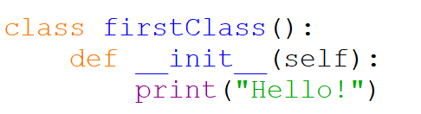
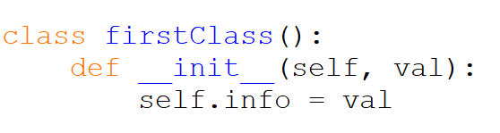
The __init__() Function
the constructor's name is always __init__;
it has to have at least one parameter. The parameter is used to represent the newly created object - you can use the parameter to manipulate the object, and to enrich it with the needed properties.
note: the obligatory parameter is usually named self - it's only a convention, but you should follow it - it simplifies the process of reading and understanding your code.

Slide 10
03
Encapsulation
Access to methods and attributes

Slide 11
Encapsulation
In object-oriented programming languages, and other related fields, encapsulation refers to one of two related but distinct notions, and sometimes to the combination thereof:[3][4]
A language mechanism for restricting direct access to some of the object's components.
A language construct that facilitates the bundling of data with the methods (or other functions) operating on that data
The authors of Design Patterns discuss the tension between inheritance and encapsulation at length and state that in their experience, designers overuse inheritance. They claim that inheritance often breaks encapsulation, given that inheritance exposes a subclass to the details of its parent's implementation

Slide 12
Encapsulation, but what happens in Python?
This kind of class property exists when and only when it is explicitly created and added to an object. As you already know, this can be done during the object's initialization, performed by the constructor.
Moreover, it can be done in any moment of the object's life. Furthermore, any existing property can be removed at any time.
Such an approach has some important consequences:
different objects of the same class may possess different sets of properties;
there must be a way to safely check if a specific object owns the property you want to utilize (unless you want to provoke an exception - it's always worth considering)
each object carries its own set of properties - they don't interfere with one another in any way.
Such variables (properties) are called instance variables.

Slide 13
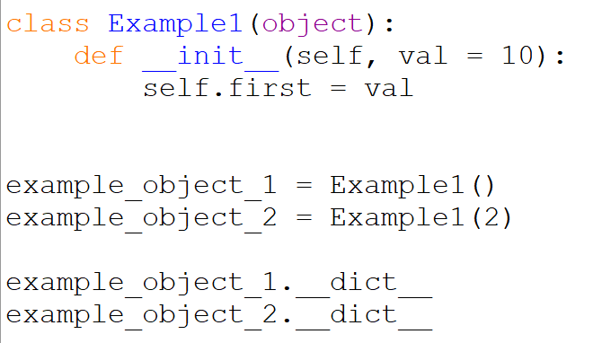
The attributes dictionary
Python objects, when created, are gifted with a small set of predefined properties and methods. Each object has got them, whether you want them or not. One of them is a variable named __dict__ (it's a dictionary).

Slide 14
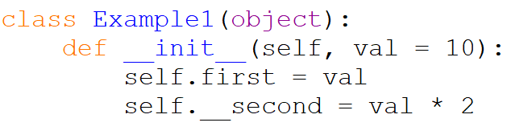
Private attributes
If we added a two underscores, in front of the variable, we make this attribute private

Slide 15
04
Simple Inheritance
The term inheritance is older than computer programming, and it describes the common practice of passing different goods from one person to another upon that person's death. The term, when related to computer programming, has an entirely different meaning.

Slide 16
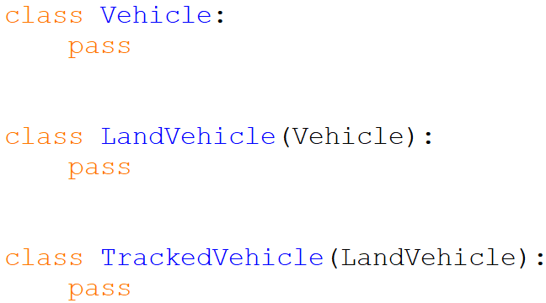
Inheritance - why and how?
Inheritance is a common practice (in object programming) of passing attributes and methods from the superclass (defined and existing) to a newly created class, called the subclass.
In other words, inheritance is a way of building a new class, not from scratch, but by using an already defined repertoire of traits. The new class inherits (and this is the key) all the already existing equipment, but is able to add some new ones if needed.
Thanks to that, it's possible to build more specialized (more concrete) classes using some sets of predefined general rules and behaviors.

Slide 17
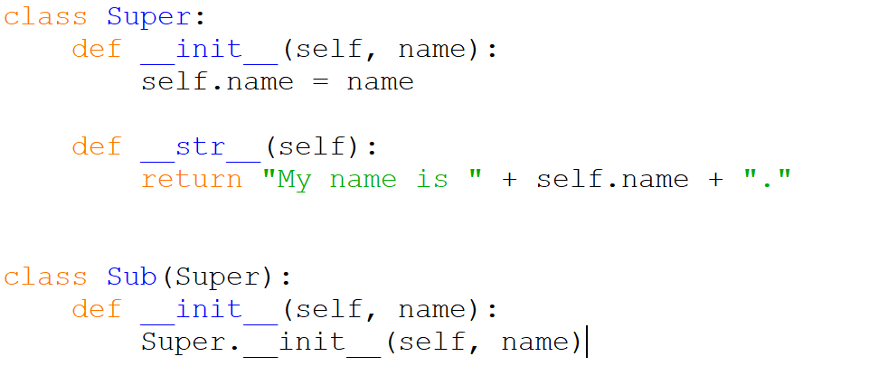
How Python finds properties and methods
Python also has a super() function that will make the child class inherit all the methods and properties from its parent.
By using the super() function, you do not have to use the name of the parent element, it will automatically inherit the methods and properties from its parent.

Slide 18
05
Multiple Inheritance
Multiple inheritance occurs when a class has more than one superclass

Slide 19
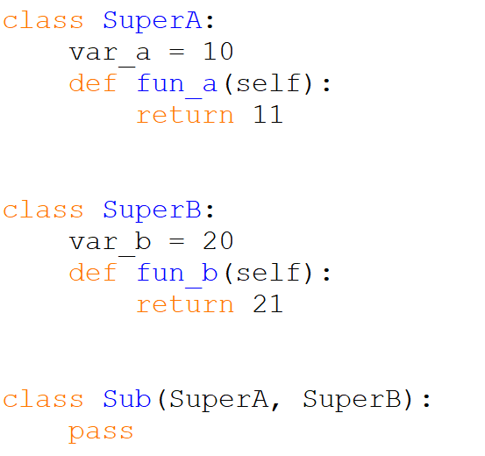
Multiple Inheritance
Multiple inheritance occurs when a class has more than one superclass. Syntactically, such inheritance is presented as a comma-separated list of superclasses put inside parentheses after the new class name - just like here:
The Sub class has two superclasses: SuperA and SuperB. This means that the Sub class inherits all the goods offered by both SuperA and SuperB.

Slide 20
06
Overload
What do you think will happen if more than one of the superclasses defines an entity of a particular name?

Slide 21
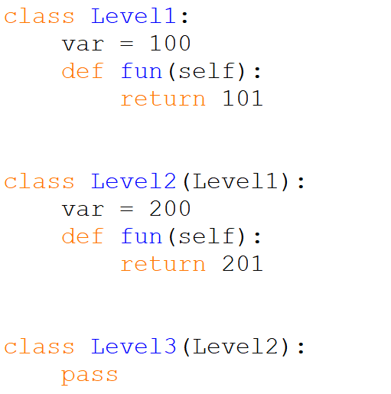
Overload
This feature can be intentionally used to modify default (or previously defined) class behaviors when any of its classes needs to act in a different way to its ancestor.
We can also say that Python looks for an entity from bottom to top, and is fully satisfied with the first entity of the desired name.
How does it work when a class has two ancestors offering the same entity, and they lie on the same level? In other words, what should you expect when a class emerges using multiple inheritance? Let's look at this.

Slide 22
07
Polymorphism
is the provision of a single interface to entities of different types or the use of a single symbol to represent multiple different types

Slide 23
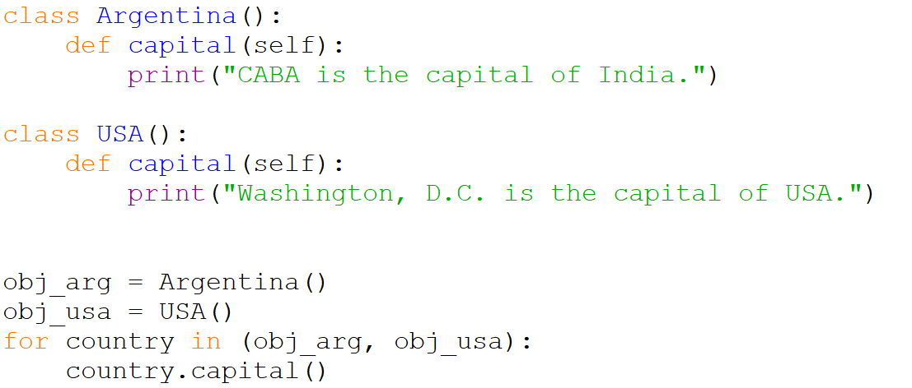
Polymorphism
The word polymorphism means having many forms. In programming, polymorphism means the same function name (but different signatures) being used for different types. The key difference is the data types and number of arguments used in function.
The below code shows how Python can use two different class types, in the same way. We create a for loop that iterates through a tuple of objects. Then call the methods without being concerned about which class type each object is. We assume that these methods actually exist in each class.

Slide 24
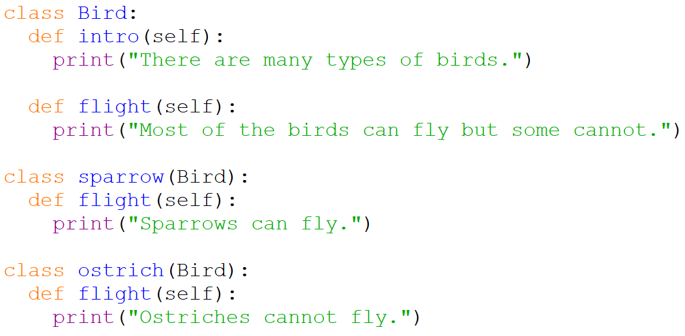
Polymorphism with Inheritance
In Python, Polymorphism lets us define methods in the child class that have the same name as the methods in the parent class. In inheritance, the child class inherits the methods from the parent class. However, it is possible to modify a method in a child class that it has inherited from the parent class. This is particularly useful in cases where the method inherited from the parent class doesn’t quite fit the child class. In such cases, we re-implement the method in the child class. This process of re-implementing a method in the child class is known as Method Overriding.

Slide 25
Thank You
November 2022

